Slide 1
Dom Modification
Mr Mack 2022

Slide 2
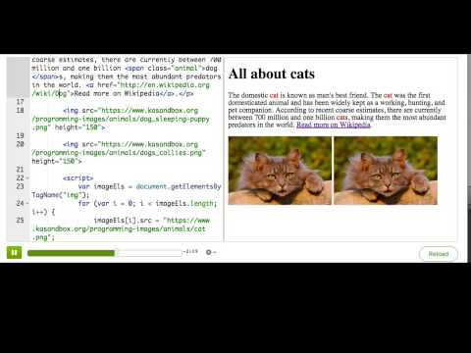
Changing attributes

Slide 3

Practice: Avatar attributes
This webpage displays a table of avatars, with a list of characteristics and images for each one. In this challenge, you'll change attributes of the images in JS. Using the variable that we've already created, use a for loop to iterate through the images and change the height attribute of each image. If you've done it right, you should see the images change size.
Change the avatar size

Slide 4

Practice: Avatar attributes
Now, use JS to add 'tooltips' to each image. A tooltip is a little bit of text that shows up when you hover over an element. You can use the title attribute to set basic tooltips on HTML tags.
In your for loop, set the title attribute of each image to the value of that image's alt attribute. You can test that it worked by hovering over the images after.
Add tooltips

Slide 5
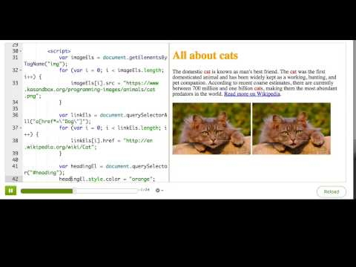
Changing styles

Slide 6

Practice: Style guide
This webpage is all about trendy styles, and you'll use JS to fill in the trends and style them with CSS properties. In this first step, use JS to set the innerHTML of colorEl to your favorite color, and then use JS to set a matching color property.
Change the color style

Slide 7

Practice: Style guide
Now use JS to set the text of handEl to your favorite celebrity's name and set a matching CSS font family property.
Change the handwriting style

Slide 8

Practice: Style guide
Finally, use JS to set the border of frameEl to some style that you think looks good.
Change the frame style

Slide 9
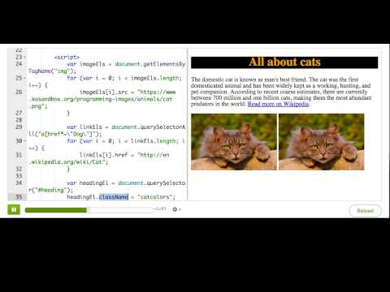
Changing CSS classes

Slide 10

Practice: Classification
This webpage displays a quiz about animal classification, with three possible answers. We've stored them into 3 variables and declared CSS rules for 2 classes at the top. Use JS to add the 'right-answer' class to rightAnswer and the 'wrong-answer' class to wrongAnswer1 and wrongAnswer2.
Add the classes

Slide 11
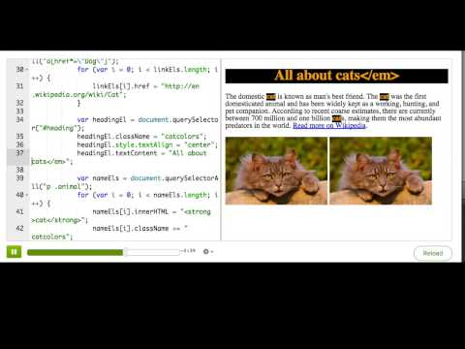
Setting innerHTML and textContent

Slide 12

Practice: The inside story
This is an inside story about the true feelings of Oh Noes and Winston, and in this challenge, you'll fill in the crucial lines. For this first step, use innerHTML to set what Oh Noes says, and include a strong or em tag somewhere in it.
What does Oh Noes say?

Slide 13
Practice: The inside story
In this step, use textContent to show what Winston says - make sure you don't include any HTML tags in it.
What does Oh Noes say?

Slide 14
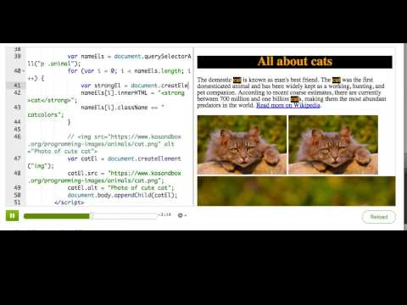
Creating elements from scratch

Slide 15
Practice: Create a solar system
This webpage is just a blank universe, and you'll fill it with planets and moons in this challenge. In this first step, use JavaScript to create a div using createElement, assign it the 'planet' class, set a nice background color for it, and finally append it to the body.
Create a planet

Slide 16
Practice: Create a solar system
In this step, create another div using createElement, assign it the 'moon' class, and append it to the planet that you just created. When you're done, feel free to add many more planets and moons!
Create a moon

Slide 17
Summary: DOM modification techniques

Slide 18
Modifying attributes
You can set an attribute on an element by setting the property of the same name. For example, to change the src of an <img>:
imgEl.src = "http://www.dogs.com/dog.gif";
In addition, you can also use the setAttribute method, like so:
imgEl.setAttribute("src", "http://www.dogs.com/dog.gif");
If you want to remove an attribute, you should do that with removeAttribute - like to remove the disabled attribute off a button, effectively enabling it:
imgEl.removeAttribute("disabled");

Slide 19
Modifying styles
You can change styles just like how you change attributes, by accessing the style property of the element, and setting the corresponding property. For example, to change the color:
headingEl.style.color = "hotpink";
Remember to "camelCase" the multi-word CSS property names, since hyphens are not valid JS property names:
headingEl.style.backgroundColor = "salmon";

Slide 20
Modifying class names
To add a class to an element, you can set the className property:
mainEl.className = "warning";
That will override any existing classes, so you should do this instead if you just want to add to the list of classes:
mainEl.className += " warning";
In newer browsers, you can use the classList functionality instead:
mainEl.classList.add("warning");

Slide 21
Modifying inner HTML / text
To completely replace the contents of an element with an arbitrary string of HTML, use innerHTML:
mainEl.innerHTML = "cats are the <strong>cutest</strong>";
If you don't need to pass in HTML tags, you should use textContent instead:
mainEl.textContent = "cats are the cutest";
Generally, you should be careful when using either of these 2 properties, because they will also remove event listeners (which we teach in the next tutorial).

Slide 22
Creating elements from scratch
There is a whole set of functions that you can use to create entirely new elements and add them to the page.
To create a new element, use the aptly named createElement:
var imgEl = document.createElement("img");
To append it to the page, call appendChild on the target parent element:
document.body.appendChild(imgEl);
Similarly, you can also use insertBefore, replaceChild, removeChild, and insertAdjacentHTML.

